Slide 2
The Sorting Problem
Input:
  A sequence of n numbers a₁, a₂, . . . , a_{n}
Output:
  A permutation (reordering) a₁’, a₂’, . . . , a_{n}’ of the input sequence such that a₁’ ≤ a₂’ ≤ · · · ≤ a_{n}’

Slide 3
Why Study Sorting Algorithms?
There are a variety of situations that we can encounter
  Do we have randomly ordered keys?
  Are all keys distinct?
  How large is the set of keys to be ordered?
  Need guaranteed performance?
Various algorithms are better suited to some of these situations

Slide 4
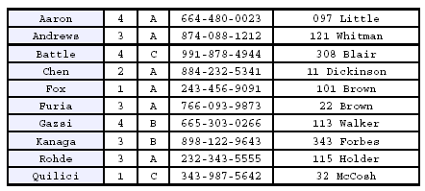
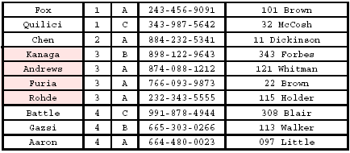
Stability
A STABLE sort preserves relative order of records with equal keys
Sort file on first key:
Sort file on second key:
Records with key value 3 are not in order on first key!!

Slide 5
Insertion Sort
Idea: like sorting a hand of playing cards
  Start with an empty left hand and the cards facing down on the table.
  Remove one card at a time from the table, and insert it into the correct position in the left hand
    compare it with each of the cards already in the hand, from right to left
  The cards held in the left hand are sorted
    these cards were originally the top cards of the pile on the table

Slide 6






Example

Slide 7
INSERTION-SORT
Alg.: INSERTION-SORT(A)
for j ← 1 to n-1
do key ← A[ j ]
Insert A[ j ] into the sorted sequence A[1 . . j -1]
i ← j - 1
while i >= 0 and A[i] > key
do A[i + 1] ← A[i]
i ← i – 1
A[i + 1] ← key
Insertion sort – sorts the elements in place
0
1
2
3
4
5
6
7
a₁
a₂
a₃
a₄
a₅
a₆
a₇
a₈
key

Slide 8
Loop Invariant for Insertion Sort
Alg.: INSERTION-SORT(A)
for j ← 1 to n-1
do key ← A[ j ]
Insert A[ j ] into the sorted sequence A[1 . . j -1]
i ← j - 1
while i >= 0 and A[i] > key
do A[i + 1] ← A[i]
i ← i – 1
A[i + 1] ← key
Invariant: a the start of the for loop the elements in A[1 . . j-1] are in sorted order

Slide 9
Proving Loop Invariants
Proving loop invariants works like induction
Initialization (base case):
  It is true prior to the first iteration of the loop
Maintenance (inductive step):
  If it is true before an iteration of the loop, it remains true before the next iteration
Termination:
  When the loop terminates, the invariant gives us a useful property that helps show that the algorithm is correct
  Stop the induction when the loop terminates

Slide 10
Loop Invariant for Insertion Sort
Initialization:
  Just before the first iteration, j = 1:
  the subarray A[1 . . j-1] = A[1], (the element originally in A[1]) – is sorted

Slide 11
Loop Invariant for Insertion Sort
Maintenance:
  the while inner loop moves A[j -1], A[j -2], A[j -3], and so on, by one position to the right until the proper position for key (which has the value that started out in A[j]) is found
  At that point, the value of key is placed into this position.

Slide 12
Loop Invariant for Insertion Sort
Termination:
  The outer for loop ends when j = n + 1 ⇒ j-1 = n
  Replace n with j-1 in the loop invariant:
    the subarray A[1 . . n] consists of the elements originally in A[1 . . n], but in sorted order
The entire array is sorted!
j - 1
j

Slide 13


Analysis of Insertion Sort
INSERTION-SORT(A)
for j ← 1 to n-1
do key ← A[ j ]
Insert A[ j ] into the sorted sequence A[1 . . j -1]
i ← j - 1
while i >= 0 and A[i] > key
do A[i + 1] ← A[i]
i ← i – 1
A[i + 1] ← key
cost times
c₁ n
c₂ n-1
0 n-1
c₄ n-1
c₅
c₆
c₇
c₈ n-1
Notes:
₇

Slide 14
Best Case Analysis
The array is already sorted
  A[i] ≤ key upon the first time the while loop test is run (when i = j -1)
  t_{j} = 1
T(n) = c₁n + c₂(n -1) + c₄(n -1) + c₅(n -1) + c₈(n-1) = (c₁ + c₂ + c₄ + c₅ + c₈)n + (c₂ + c₄ + c₅ + c₈)
= an + b = Θ(n)
“while i > 0 and A[i] > key”

Slide 15
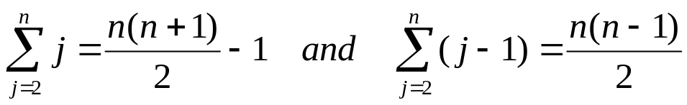

Worst Case Analysis
The array is in reverse sorted order
  Always A[i] > key in while loop test
  Have to compare key with all elements to the left of the j-th position ⇒ compare with j-1 elements ⇒ t_{j} = j
  a quadratic function of n
T(n) = Θ(n²) order of growth in n²
“while i > 0 and A[i] > key”

Slide 16
Comparisons and Exchanges in Insertion Sort
INSERTION-SORT(A)
for j ← 1 to n-1
do key ← A[ j ]
Insert A[ j ] into the sorted sequence A[1 . . j -1]
i ← j - 1
while i >= 0 and A[i] > key
do A[i + 1] ← A[i]
i ← i – 1
A[i + 1] ← key
cost times
c₁ n
c₂ n-1
0 n-1
c₄ n-1
c₅
c₆
c₇
c₈ n-1
≈ n²/2 comparisons
≈ n²/2 exchanges

Slide 17
Insertion Sort - Summary
Idea: like sorting a hand of playing cards
  Start with an empty left hand and the cards facing down on the table.
  Remove one card at a time from the table, and insert it into the correct position in the left hand
Advantages
  Good running time for “almost sorted” arrays Θ(n)
Disadvantages
  Θ(n²) running time in worst and average case
  ≈ n²/2 comparisons and exchanges

Slide 18
Bubble Sort
Idea:
  Repeatedly pass through the array
  Swaps adjacent elements that are out of order
Easier to implement, but slower than Insertion sort
i
0
1
2
n
8
4
6
9
2
3
1
j

Slide 19
Example
8
4
6
9
2
3
1
1
8
4
6
9
2
3
i = 0
j
i = 1
j
8
4
6
9
2
1
3
1
2
8
4
6
9
3
i = 0
j
i = 2
j
8
4
6
9
1
2
3
1
2
3
8
4
6
9
i = 0
j
i = 3
j
8
4
6
1
9
2
3
1
2
3
4
8
6
9
i = 0
j
i = 4
j
8
4
1
6
9
2
3
1
2
3
4
6
8
9
i = 0
j
i = 5
j
8
1
4
6
9
2
3
1
2
3
4
6
8
9
i = 0
j
i = 6
1
8
4
6
9
2
3
j
i = 1
j

Slide 20
Bubble Sort
Alg.: BUBBLESORT(A)
for i ← 0 to length[A]-1
do for j ← length[A]-1 downto i + 1
do if A[j] < A[j -1]
then exchange A[j] ↔ A[j-1]
i
8
4
6
9
2
3
1
i = 0
j

Slide 21




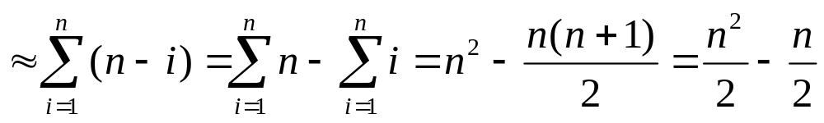
Bubble-Sort Running Time
Alg.: BUBBLESORT(A)
for i ← 0 to length[A]-1
do for j ← length[A]-1 downto i + 1
do if A[j] < A[j -1]
then exchange A[j] ↔ A[j-1]
Comparisons: ≈ n²/2
Exchanges: ≈ n²/2
T(n) =
c₁(n+1) +
c₂
c₃
c₄
= Θ(n) +
(c₂ + c₂ + c₄)
T(n) = Θ(n²)

Slide 22
Selection Sort
8
4
6
9
2
3
1
Idea:
  Find the smallest element in the array
  Exchange it with the element in the first position
  Find the second smallest element and exchange it with the element in the second position
  Continue until the array is sorted
Invariant:
  All elements to the left of the current index are in sorted order and never changed again
Disadvantage:
  Running time depends only slightly on the amount of order in the file

Slide 23
Example
8
4
6
9
2
3
1
1
2
3
4
9
6
8
1
4
6
9
2
3
8
1
2
3
4
6
9
8
1
2
6
9
4
3
8
1
2
3
4
6
8
9
1
2
3
9
4
6
8
1
2
3
4
6
8
9

Slide 24
Selection Sort
Alg.: SELECTION-SORT(A)
n ← length[A]
for j ← 0 to n - 2
do smallest ← j
for i ← j + 1 to n-1
do if A[i] < A[smallest]
then smallest ← i
exchange A[j] ↔ A[smallest]
8
4
6
9
2
3
1

Slide 25


Analysis of Selection Sort
Alg.: SELECTION-SORT(A)
n ← length[A]
for j ← 0 to n - 2
do smallest ← j
for i ← j + 1 to n-1
do if A[i] < A[smallest]
then smallest ← i
exchange A[j] ↔ A[smallest]
cost times
c₁ 1
c₂ n
c₃ n-1
c₄
c₅
c₆
c₇ n-1
n²/2
comparisons
n
exchanges

Slide 26

Readings
Cormen: Chapter 2

